Slide 1
String Matching

Slide 2
Introduction
Text-editing programs frequently need to find all occurrences of a pattern in the text.
Typically, the text is a document being edited, and the pattern searched for is a particular word supplied by the user.
Efficient algorithms for this problem—called “string matching”—can greatly aid the responsiveness of the text-editing program.

Slide 3
Applications of String Matching
Among their many other applications, string-matching algorithms search for particular patterns in DNA sequences.
Internet search engines also use them to find Web pages relevant to queries.

Slide 4
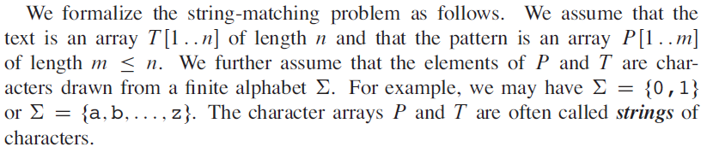
Definition

Slide 5
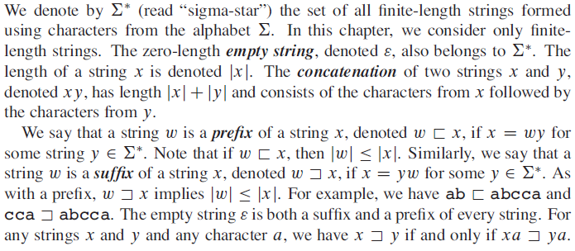
Notations and Terminology

Slide 6
The naive string-matching algorithm

Slide 7
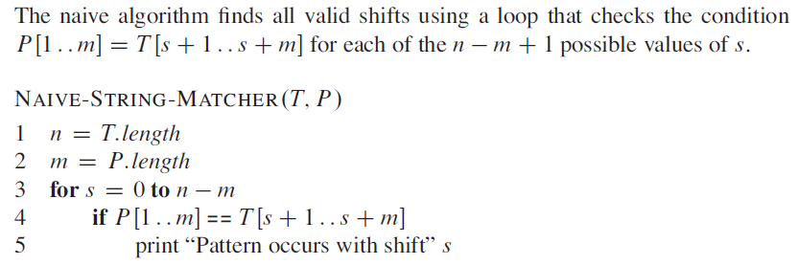
The naive string-matching algorithm

Slide 8
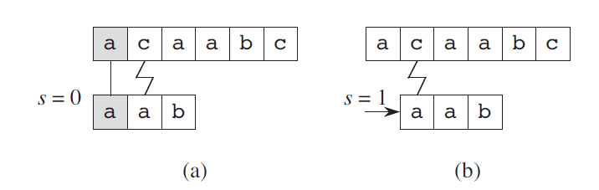
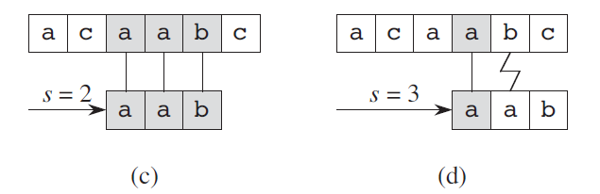
NAIVE-STRING-MATCHER : Working

Slide 9
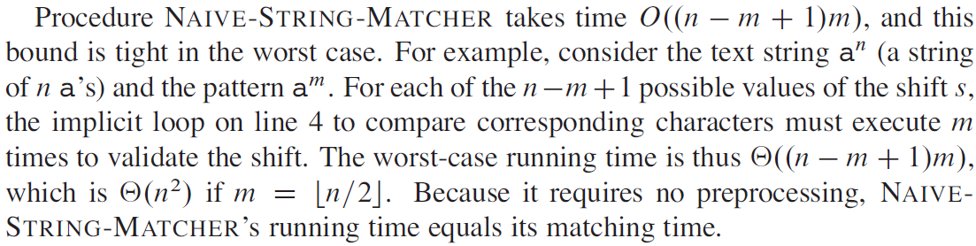
Analysis of NAIVE-STRING-MATCHER

Slide 10
The Rabin-Karp algorithm

Slide 11
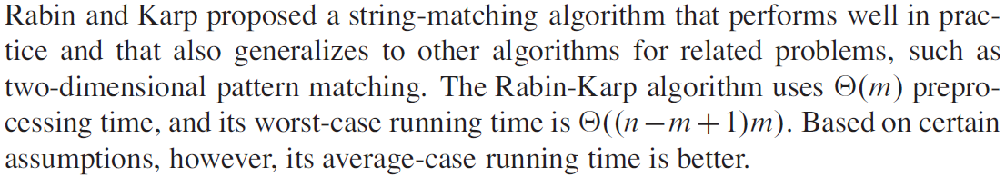
The Rabin-Karp algorithm

Slide 12
The Rabin-Karp algorithm
Works on the idea that the substrings having the same length as that of P and give the same modulus with a number, say q, and can be isolated from T.
These strings can then be compared with P.
If the strings match, then the initial index of the substring in T can be printed.

Slide 13
Example
Say
the substring is ‘5623’,
q is 13
T is ‘789562378563267’.
m and n denote the length of P and T, respectively.
‘5623’ mod 13 is 7.
The first step would be to find all strings of length m from T. This is followed by taking mod 13 of all the substrings.

Slide 14
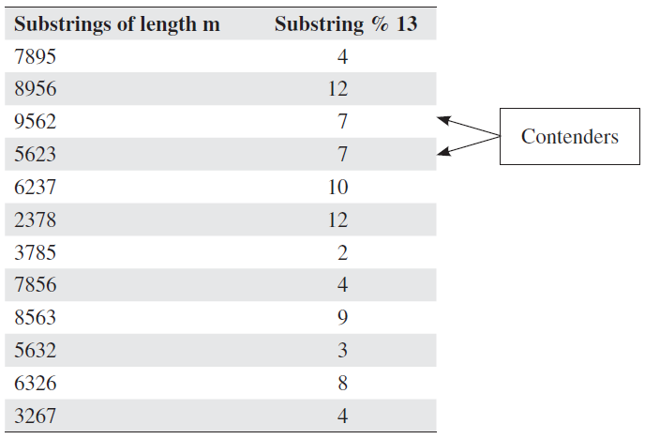
Example : Substrings of length m from T, and their mod 13

Slide 15
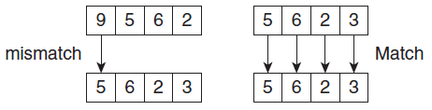
Example
The strings with the value 7 are the contenders for the correct match.
In this case, there are two such strings.
These strings are then compared with P.
The second string does not match P and hence would be dubbed as a spurious match or spurious hit.

Slide 16
Rabin–Karp algorithm
Input: T[0…(n-1)], P[0…(m-1)]
Output: The starting index of the matching substring, if string is found else -1.
Rabin–Karp Algorithm(T[0…(n-1)], P[0..(m-1)]
modT := mod(T[0..(m-1)], q); modP := mod(s[0..(m-1)], q)
for i from 1 to n-m+1
if modP = modT
if T[i..i+m-1] = P
return i
modP := mod(s[i+1..i+m], q)
return not found

Slide 17
Working of Algorithm
The modT variable holds the value of mod of the substring of T (equal in length to P) and modP stores the value of mod of P with q.
If these are equal, the characters are compared, otherwise the control moves one step forward.

Slide 18
Analysis
The contentious point is to find the value of the substring in order to calculate its mod.
This, if done in the conventional way, would lead to quadratic complexity.
In order to make the things efficient, recursion can be used.
The complexity becomes O(m(n − m + 1)) in the worst case.
It may be noted though that the number of comparisons are reduced as compared to naïve string matching.

Slide 19
Quick Reference
Rabin-Karp String Matching Algorithm
https://www.youtube.com/watch?v=qQ8vS2btsxI

Slide 20
Knuth-Morris-Pratt algorithm (KMP)

Slide 21
Knuth-Morris-Pratt algorithm (KMP)
Knuth, Morris and Pratt proposed a linear time algorithm for the string matching problem.
A matching time of O(n) is achieved by avoiding comparisons with elements of ‘T’ that have previously been involved in comparison with some element of the pattern ‘P’ to be matched. i.e., backtracking on the string ‘T’ never occurs

Slide 22
KMP Algorithm
The prefix function
The prefix function, for a pattern encapsulates knowledge about how the pattern matches against shifts of itself.
This information can be used to avoid useless shifts of the pattern ‘P’.
In other words, this enables avoiding backtracking on the string ‘T’.
The KMP Matcher
With string ‘T’, pattern ‘P’ and the Compute-Prefix-Function(π) as inputs, finds the occurrence of ‘P’ in ‘T’ and returns the number of shifts of ‘P’ after which occurrence is found.

Slide 23
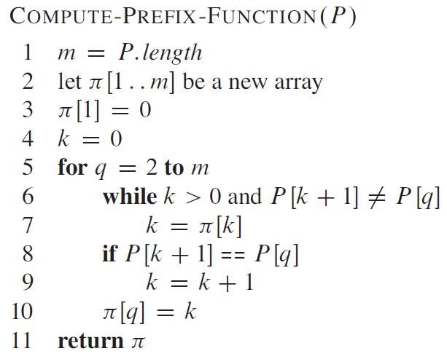
KMP Algorithm : Compute-Prefix-Function (π)

Slide 24
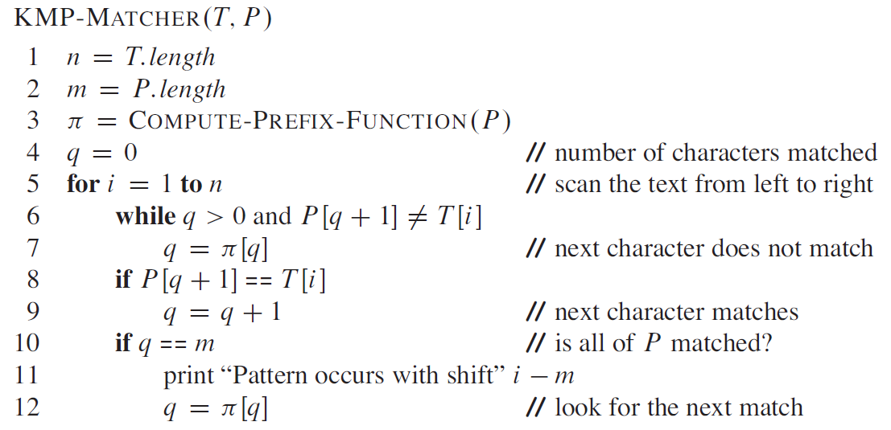
KMP Algorithm

Slide 25
Example: compute π for the pattern ‘p’ below:
P
a | b | a | b | a | c | a
Initially: m = length[p] = 7
π[1] = 0
k = 0
Step 1: q = 2, k=0
π[2] = 0
Step 2: q = 3, k = 0,
π[3] = 1
Step 3: q = 4, k = 1
π[4] = 2
q | 1 | 2 | 3 | 4 | 5 | 6 | 7
p | a | b | a | b | a | c | a
π | 0 | 0
q | 1 | 2 | 3 | 4 | 5 | 6 | 7
p | a | b | a | b | a | c | a
π | 0 | 0 | 1
q | 1 | 2 | 3 | 4 | 5 | 6 | 7
p | a | b | a | b | a | c | A
π | 0 | 0 | 1 | 2

Slide 26
Step 4: q = 5, k =2
π[5] = 3
Step 5: q = 6, k = 3
π[6] = 0
(k sets to 1, then to 0)
Step 6: q = 7, k = 0
π[7] = 1
After iterating 6 times, the prefix function computation is complete:
q | 1 | 2 | 3 | 4 | 5 | 6 | 7
p | a | b | a | b | a | c | a
π | 0 | 0 | 1 | 2 | 3
q | 1 | 2 | 3 | 4 | 5 | 6 | 7
p | a | b | a | b | a | c | A
π | 0 | 0 | 1 | 2 | 3 | 0
q | 1 | 2 | 3 | 4 | 5 | 6 | 7
p | a | b | a | b | a | c | a
π | 0 | 0 | 1 | 2 | 3 | 0 | 1
q | 1 | 2 | 3 | 4 | 5 | 6 | 7
p | a | b | a | b | a | c | a
π | 0 | 0 | 1 | 2 | 3 | 0 | 1

Slide 27
Illustration: given a String ‘T’ and pattern ‘p’ as follows:
T
b | a | c | b | a | b | a | b | a | b | a | c | a | c | a
P
a | b | a | b | a | c | a
Let us execute the KMP algorithm to find whether ‘P’ occurs in ‘T’.
For ‘P’ the prefix function, π was computed previously and is as follows:
q | 1 | 2 | 3 | 4 | 5 | 6 | 7
p | a | b | a | b | a | c | a
π | 0 | 0 | 1 | 2 | 3 | 0 | 1

Slide 28
Initially: n = size of T = 15;
m = size of P = 7
Step 1: i = 1, q = 0
comparing P[1] with T[1]
T
b | a | c | b | a | b | a | b | a | b | a | c | a | a | b
P
a | b | a | b | a | c | a
P[1] does not match with T[1]. ‘p’ will be shifted one position to the right.
Step 2: i = 2, q = 0
comparing P[1] with T[2]
T
b | a | c | b | a | b | a | b | a | b | a | c | a | a | b
P
a | b | a | b | a | c | a
P[1] matches T[2]. Since there is a match, P is not shifted.

Slide 29
Step 3: i = 3, q = 1
Comparing P[2] with T[3]
P[2] does not match with T[3]
T
b | a | c | b | a | b | a | b | a | b | a | c | a | a | b
P
a | b | a | b | a | c | a
Backtracking on P, comparing P[1] and T[3]
Step 4: i = 4, q = 0
comparing P[1] with T[4]
P[1] does not match with T[4]
T
b | a | c | b | a | b | a | b | a | b | a | c | a | a | b
P
a | b | a | b | a | c | a
Step 5: i = 5, q = 0
comparing P[1] with T[5]
P[1] matches with T[5]
T
b | a | c | b | a | b | a | b | a | b | a | c | a | a | b
P
a | b | a | b | a | c | a

Slide 30
Step 6: i = 6, q = 1
Comparing P[2] with T[6]
P[2] matches with T[6]
T
b | a | c | b | a | b | a | b | a | b | a | c | a | a | b
P
a | b | a | b | a | c | a
Step 7: i = 7, q = 2
Comparing P[3] with T[7]
P[3] matches with T[7]
T
b | a | c | b | a | b | a | b | a | b | a | c | a | a | b
P
a | b | a | b | a | c | a
Step 8: i = 8, q = 3
Comparing P[4] with T[8]
P[4] matches with T[8]
T
b | a | c | b | a | b | a | b | a | b | a | c | a | a | b
P
a | b | a | b | a | c | a

Slide 31
Step 9: i = 9, q = 4
Comparing P[5] with T[9]
P[5] matches with T[9]
T
b | a | c | b | a | b | a | b | a | b | a | c | a | a | b
P
a | b | a | b | a | c | a
Step 10: i = 10, q = 5
Comparing P[6] with T[10]
P[6] doesn’t match with T[10]
T
b | a | c | b | a | b | a | b | a | b | a | c | a | a | b
P
a | b | a | b | a | c | a
Backtracking on P, comparing P[4] with T[10] because after mismatch q = π[5] = 3
Step 11: i = 11, q = 4
Comparing P[5] with T[11]
P[5] matches with T[11]
b | a | c | b | a | b | a | b | a | b | a | c | a | a | b
T
P
a | b | a | b | a | c | a

Slide 32
Step 12: i = 12, q = 5
Comparing P[6] with T[12]
P[6] matches with T[12]
T
b | a | c | b | a | b | a | b | a | b | a | c | a | a | b
P
a | b | a | b | a | c | a
Step 13: i = 13, q = 6
Comparing P[7] with T[13]
P[7] matches with T[13]
T
b | a | c | b | a | b | a | b | a | b | a | c | a | a | b
P
a | b | a | b | a | c | a
Pattern ‘P’ has been found to completely occur in string ‘T’. The total number of shifts
that took place for the match to be found are: i – m = 13 – 7 = 6 shifts.

Slide 33
Quick Reference
Knuth-Morris-Pratt (KMP) String Matching Algorithm
https://www.youtube.com/watch?v=V5-7GzOfADQ
Explains both Naïve algorithm and KMP algorithm

Slide 34
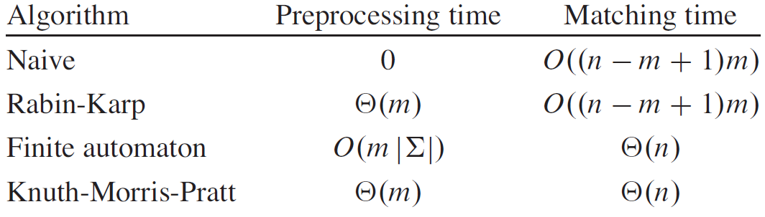
Few String Matching Algorithms and their preprocessing and matching time

Slide 35
Books Referred
Introduction to Algorithms, 3rd Edition, Cormen Thomas H., Leiserson Charles E., Rivest Ronald L., Stein Cliffort
Algorithms: Design and Analysis, Harsh Bhasin, OXFORD

Slide 36
End

